Slide 1

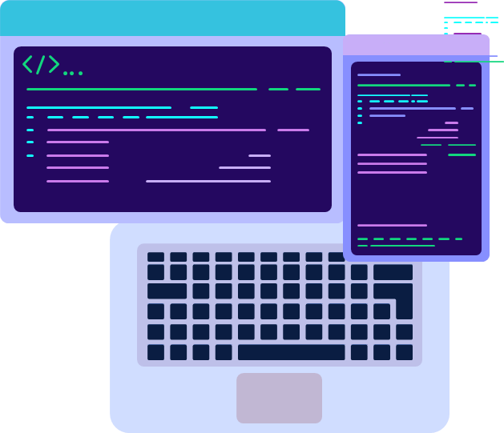
MACHINE LEARNING WORKSHOP
DAY 2

Slide 2
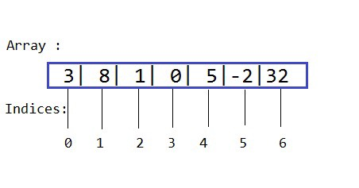
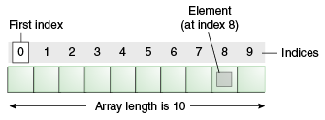
Arrays
An array is a data structure which can hold more than one value at a time.It is the collection or ordered series of elements of the same type.

Slide 3
Difference between python lists and arrays?
Python arrays and lists have the same way of storing data.
Arrays take only a single data type elements but lists can have any kind of datatype
Slicing and Looping are same for both but multiplication and division operations cannot be performed in lists

Slide 4
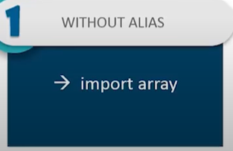
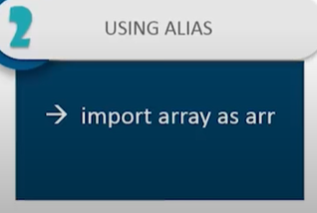
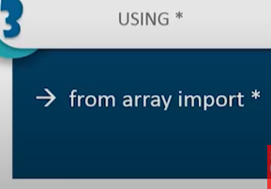
How to create arrays in python?
To create arrays you have to import array module .

Slide 5
Operators in Python
Arithmetic Operators
Assignment Operators
Comparison Operators

Slide 6
1. Arithmetic Operators
∕
✶✶
✶
%

Slide 7
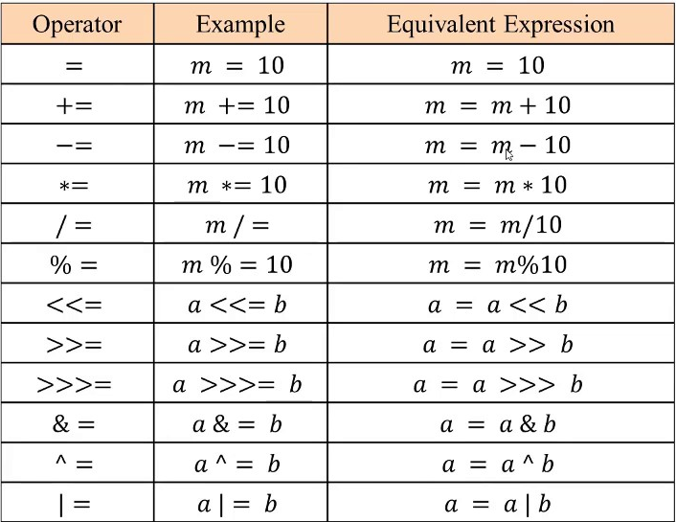
2.Assignment Operators
Assignment Operators are used to assign values

Slide 8
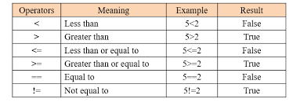
3. Comparison Operators
Comparison operators are used to compare between two values.

Slide 9
Conditonal Statements

Slide 10
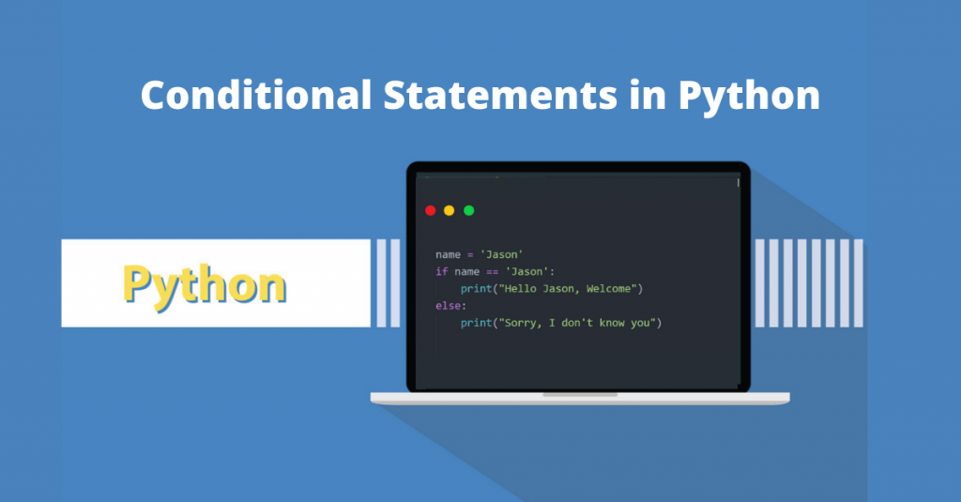

Slide 11
If Statement
Only executes if the condition in the if statement is true
The syntax for if statement:
If expression:
statement
Example:
a = 25
b = 170
if b > a:
print("b is greater than a")
output : b is greater than a

Slide 12
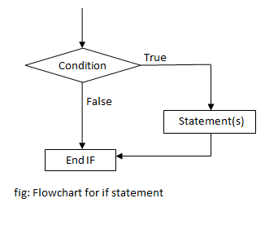

Slide 13
If-Else Statements
This statement is used when both the true and false parts of a given condition are specified to be executed. When the condition is true, the statement inside the if block is executed; if the condition is false, the statement outside the if block is executed.
Syntax
Example
if condition :
#Will executes this block if the condition is true
else :
#Will executes this block if the condition is false
num = 5
if num >= 0:
print("Positive or Zero")
else:
print("Negative number")
output : Positive or Zero

Slide 14
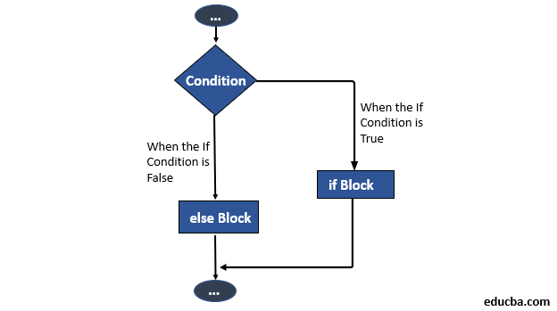

Slide 15
If-elif
In this case, the If condition is evaluated first. If it is false, the Elif statement will be executed; if it also comes false, the Else statement will be executed.
Syntax
Example
if condition :
Body of if
elif condition :
Body of elif
else:
Body of else
num = 7
if num > 0:
print("Positive number")
elif num == 0:
print("Zero")
else:
print("Negative number")
output: Positive number

Slide 16
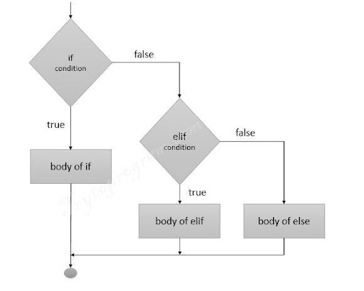
If else,elif conditional statements

Slide 17
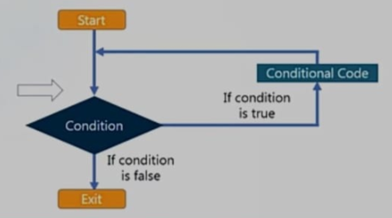
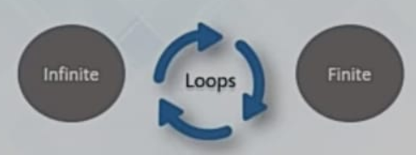
Loops in Python
Loop allows the execution of a statement or a group of statement multiple times.
In order to enter the loop there are certain conditions defined in the beginning.
Once the condition becomes false the loop stops and the control moves out of the loop.

Slide 18
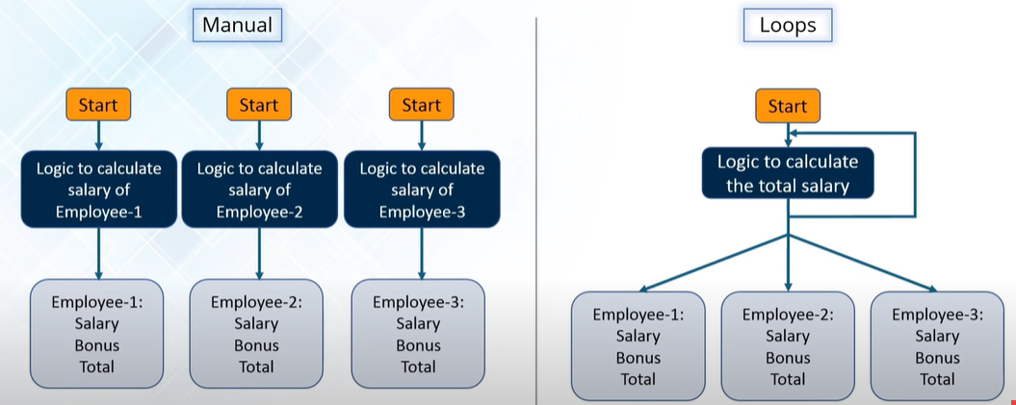

Slide 19
Types of Loop in Python
For Loop
While Loop
Nested Loop

Slide 20
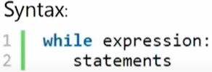
While Loop
It continually executes the statements(code) as long as the given condition is TRUE.
Example:
i=0
while i<9:
print('Number:', i)
i=i+1
print("We have printed the numbers till 8")

Slide 21
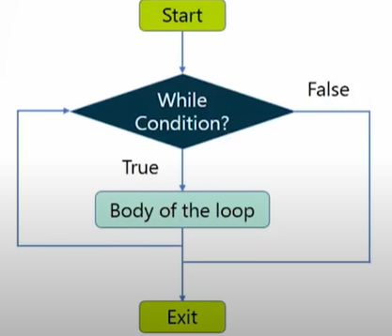

Slide 22
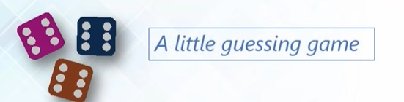
Example for While loop:

Slide 23
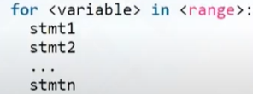
For Loop in Python
A for loop is used to iterate over a sequence like lists, type, dictionaries, sets, or even strings.
Loop statements will be executed for each item of the sequence.
Syntax
Example:
n = 4
for i in range(0, n):
print(i)

Slide 24
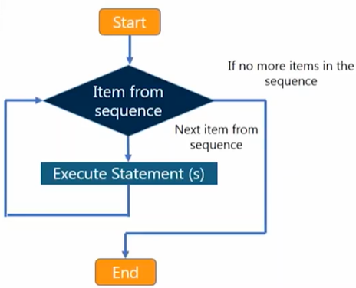

Slide 25
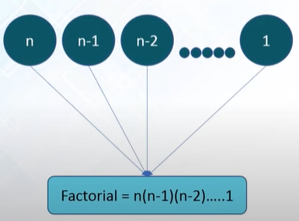
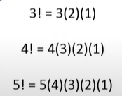
Example for For loop Find Factorial

Slide 26
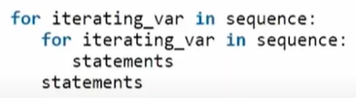
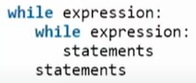
Nested Loops in Python
for i in range(1,11):
for j in range(1,11):
print(i*j, end=' ')
print("\n")
i = 1
while i <= 4 :
j = 0
while j <= 3 :
print(i*j, end=" ")
j += 1
print()
i += 1

Slide 27
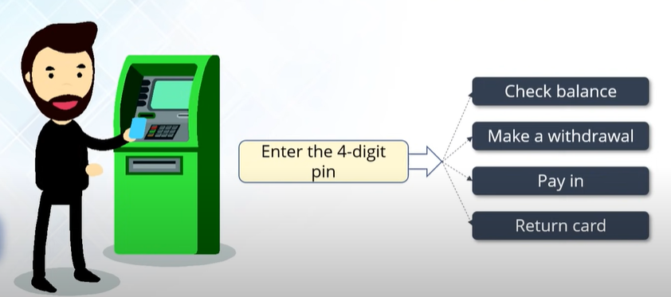
Example of Nested Loops

Slide 28
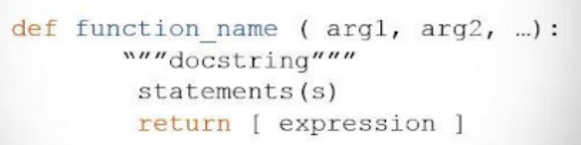
Functions in Python
Functions provide a way to break problems or processes down into smaller and independent blocks of code.
A function is a block of organized,reusable code that is used to perform some task
It is usually called by its name when its task needs execution .
You can also pass values to it or have it return results to you.

Slide 29
Types of Function
Built-in Functions
User defined functions

Slide 30
Built-In Functions
bool()
type()
sorted()
print()
pow()
min()
len()
map()

Slide 31
User defined Functions
Creating a function
Calling a function
Def my_function():
print(“Hello from a function”)
Def my_function():
print(“Hello from a function”)
my _function()

